Slide 1


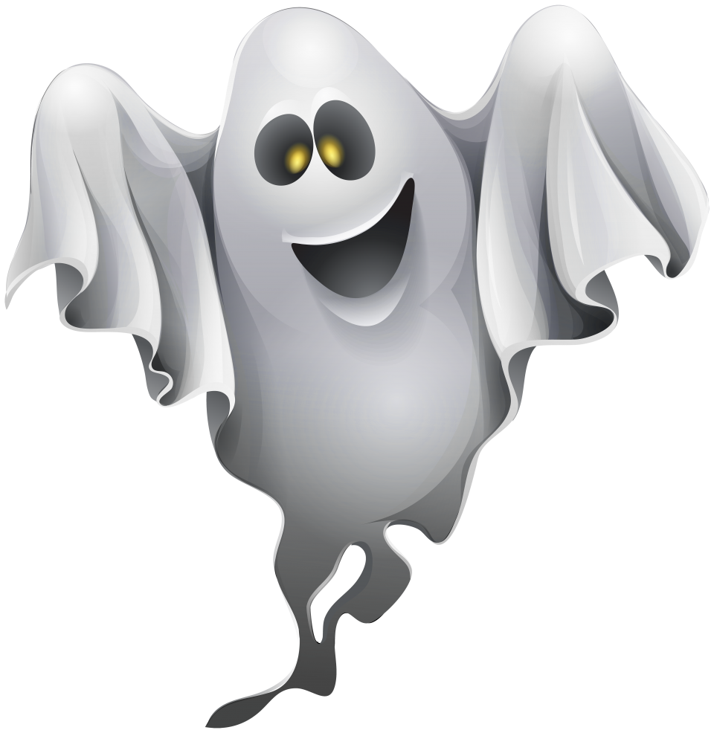

HOLIDAYS;
Halloween

Slide 2





Do you know any Halloween words?
bat
ghost
cat
HALLOWEEN
When do we celebrate Halloween?

Slide 3
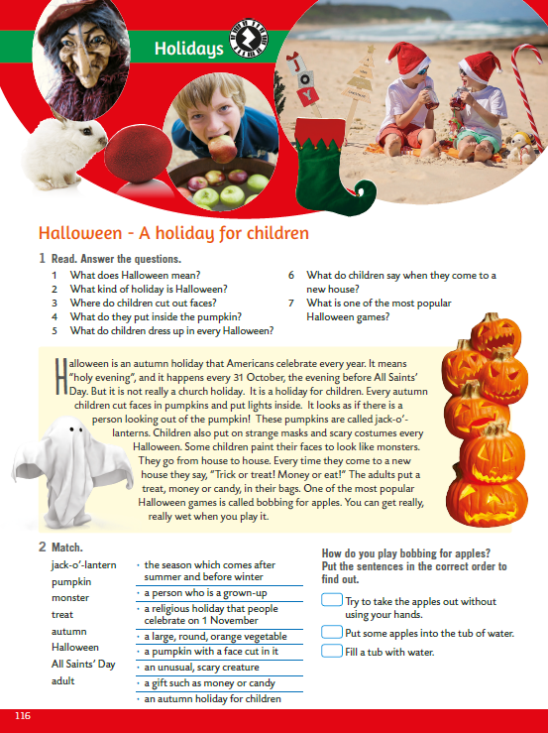
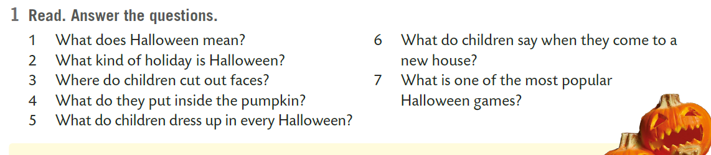
Open your books, page 116.
Do you know the answers?

Slide 4
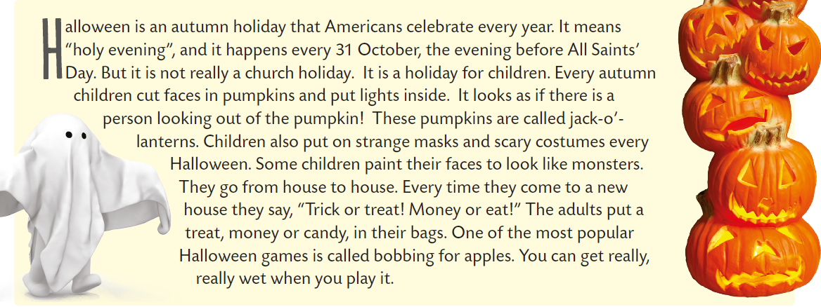
Read the text.

Slide 5
Answer the questions from task 1.
Halloween means „holy evening”.
It’s a holiday for children.
Children cut faces in pumpkins.
They put lights inside.
Children put on strange masks and scary costumes and they paint their faces to look like monsters.
When they come to a new house they say, “Trick or treat! Money or eat!”
One of the most popular Halloween games is bobbing for apples.

Slide 6
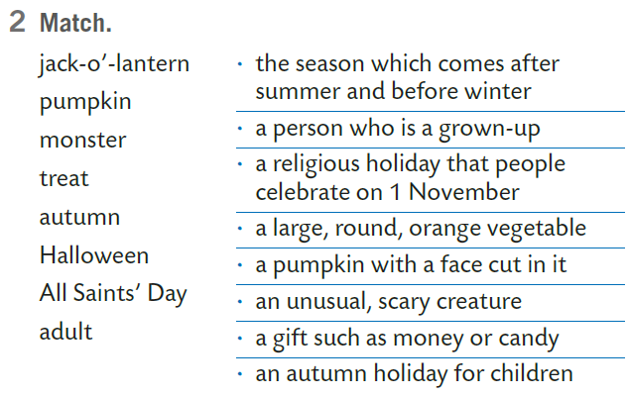
Match.
1
2
3
4
5
6
7
8
5
8
7
2
1
3
4
6
Practice here:
https://wordwall.net/resource/5766162

Slide 7
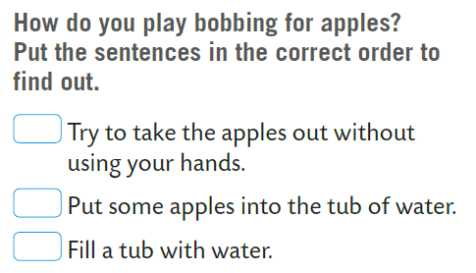
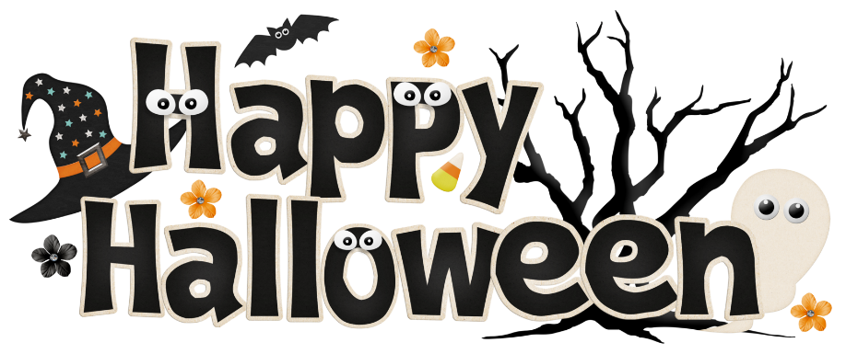
How do you play bobbing for apples? Put the sentences in the correct order to find out.
.
3
2
1

